Slide 1
Atomic Structure
Mass number
Number of protons and neutrons
 | Proton | Neutron | Electron
Relative mass | 1 | 1 | negligible
Charge | + | 0 | -
location | nucleus | nucleus | shells
35
Cl
17
Atomic number
Number of protons
The relative atomic mass of an element (Ar) compares the mass of atoms of the element with the 12C isotope. It is an average value for the isotopes of the element.
Atoms of the same element can have different
numbers of neutrons - these atoms are called
isotopes of that element.
Same atomic number
Different mass number
The relative formula mass (Mr) of a compound is the sum of the relative atomic masses of the atoms in the numbers shown in the formula.
The relative formula mass of a substance, in grams, is known as one mole of that substance

Slide 2
10 Questions
35
24
Using the following information about Cl and Mg answer the question below…
Cl
Mg
17
12
What is the mass number of this chlorine atom?
What is the atomic number of this chlorine atom?
How many protons neutrons and electrons does this chlorine atom have?
What is the electron configuration of a chlorine atom?
What is the relative mass of an electron?
What is the charge on a neutron particle?
Where in the atomic structure are electrons located?
What is the relative atomic mass of chlorine?
Using ³⁵Cl and ³⁷Cl as examples explain what is meant by an isotope.
What is the relative formula mass (Mr) of MgCl₂?
Atomic Structure

Slide 3
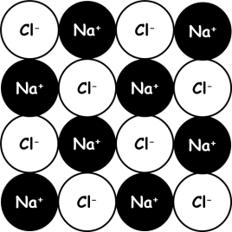
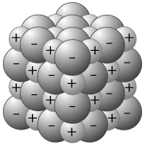
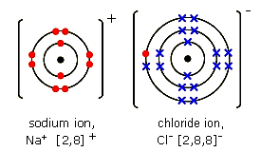
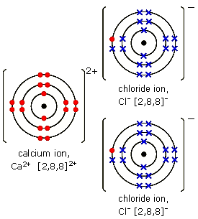
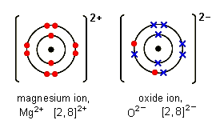
Ionic bonding
Metal and non-metal – electron transfer
Metals lose electrons and become positive ions.
Non-metals gain electrons and become negative ions.
Writing formulae
The charges on the positive and
negative ions need to balance out
Na⁺ Cl⁻ → NaCl
Mg²⁺ O²⁻ → MgO
Ca²⁺ Cl⁻ Cl⁻ → CaCl₂
Metals in group 1 form ions with a +1 charge
Metals in group 2 form ions with a +2 charge
…
Non-metals in group 6 form ions with -2 charge
Non-metals in group 7 form ions with -1 charge
Properties of ionic compounds
Ionic compounds have regular
structures (giant ionic lattices)
in which there are strong
electrostatic forces in all
directions between oppositely
charged ions.
These compounds have high melting points and high boiling points because of the large amounts of energy needed to break the many strong bonds.
When melted or dissolved in water, ionic compounds conduct electricity because the ions are free to move and carry the current
sodium chloride
calcium chloride
magnesium oxide

Slide 4
10 Questions
Do ionic bonds transfer or share electrons?
Ionic bonds exist between..
(a) Metals and Non-metals,
(b) Non metals and Non-metals
(c) Metals and Metals
Elements in group 7 form ions with what charge?
Elements in group 3 form ions with what charge?
Ionic compounds are held together by strong forces in all directions between oppositely charged ions.
Under what 2 conditions will ionic compounds conduct electricity?
Draw a diagram to show the electron arrangement in a fluorine ion.
Draw a diagram to show the electron arrangement in a magnesium ion.
What is the electron configuration of a fluorine ion?
What is the formula of calcium fluoride?
E _ _ _ _ _ _ _ _ _ _ _ C
Ionic bonding

Slide 5
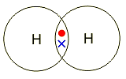
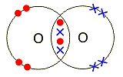
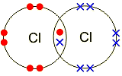
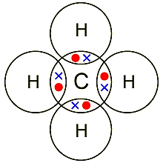
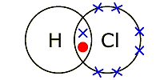
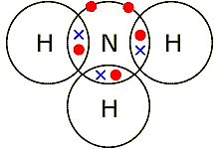
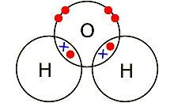
Covalent bonding - molecules
Hydrogen - H₂ (g)
Oxygen - O₂ (g)
Properties of covalent compounds
A covalent bond is a shared pair of electrons
Substances that consist of simple molecules are gases, liquids or solids that have relatively low melting points and boiling points
They have only weak forces between the molecules (intermolecular forces). It is these intermolecular forces that are overcome, not the covalent bonds, when the substance melts or boils. Intermolecular forces are much weaker than covalent bonds. The forces within the molecules (the covalent bonds) can be referred to as intramolecular forces.
They do not conduct electricity because the molecules do not have an overall electric charge. No free electrons or ions.
Chlorine - Cl₂ (g)
Methane – CH₄ (g)
Hydrogen chloride
HCl (g)
Ammonia – NH₃ (g)
Water – H₂O (l)

Slide 6
10 Questions
Do covalent bonds transfer or share electrons?
covalent bonds exist between..
(a) Metals and Non-metals,
(b) Non metals and Non-metals
(c) Metals and Metals
Elements in group 7 form covalent compounds with how many bonds?
Elements in group __ form covalent compounds with 3 bonds?
Why do covalent compounds NOT conduct electricity?
Are covalent bonds strong or weak?
Draw a diagram to show the electron arrangement in a carbon atom.
Draw a dot-cross diagram to show the bonding between 2 fluorine atoms
Draw a dot-cross diagram to show the bonding present in CH₄?
How many bonds does carbon form in CO₂?
Covalent bonding - molecules

Slide 7
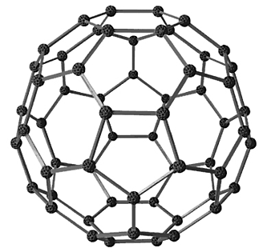
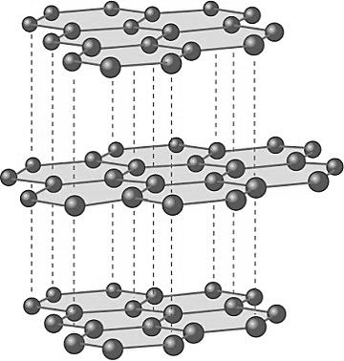
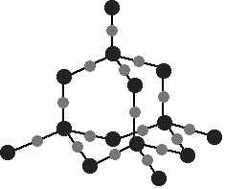
Covalent bonding - Giant
Diamond (carbon only) | All the atoms in these structures are linked to other atoms by strong covalent bonds and so they have very high melting points.
In diamond, each carbon atom forms four covalent bonds with other carbon atoms in a giant covalent structure, so diamond is very hard. | Silicon dioxide (Si + O) Sand
Fullerenes (carbon only) | Carbon can also form fullerenes with different numbers of carbon atoms. They are used for drug delivery into the body, lubricants, catalysts, and in nanotubes for reinforcing materials, eg tennis rackets.
In graphite, each carbon atom bonds to three others, forming layers. The layers are free to slide over each other because there are no covalent bonds between the layers and so graphite is soft and slippery. | Graphite (carbon only)
Giant covalent structures are also called macromolecules.
In graphite, one electron from each carbon atom
is delocalised. These delocalised electrons
allow graphite to conduct heat and electricity.

Slide 8
10 Questions
How many bonds do carbon atoms form in diamond?
How many bonds do carbon atoms form in graphite?
Why is graphite soft and slippery?
Why can graphite conduct electricity?
What can diamond not conduct electricity?
What is the chemical name for sand?
Giant covalent structures are also called __________?
Do giant covalent structures have high or low melting points?
Explain your answer to question 8.
HT only
Give a use for fullerenes.
Covalent bonding - Giant

Slide 9
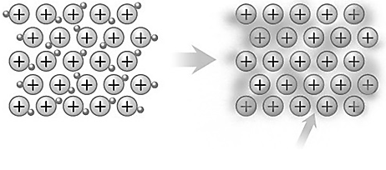
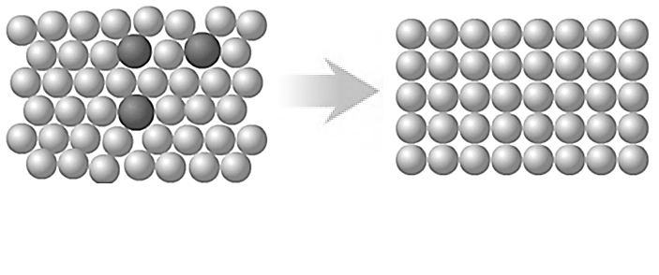
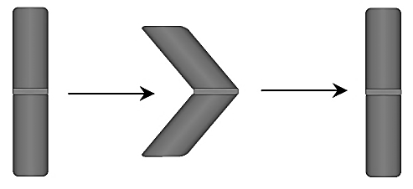
Metallic bonding
Alloys
Alloys are usually made from two or more different metals. The different sized atoms of the metals distort the layers in the structure, making it more difficult for them to slide over each other and so make alloys harder than pure metals.
Conduction depends on the ability of electrons to move throughout the metal.
Positive ions in a sea of delocalised electrons
Metals
Metals consist of giant structures of atoms arranged in a regular pattern.
The electrons in the highest occupied energy levels (outer shell) of metal atoms are delocalised and so free to move through the whole structure.
a structure of positive ions with electrons between the ions holding them together by strong electrostatic attractions.
Metals conduct heat and electricity because of the delocalised electrons in their structures.
The layers of atoms in metals are able to slide over each other and so metals can be bent and shaped.
Different sized atoms do not form a regular pattern.
Shape memory
Alloys can return to their original shape after being deformed, eg Nitinol used in dental braces.
force
heat

Slide 10
10 Questions
What type of bonding do metals have?
Draw a diagram to show the arrangement of atoms in a metal.
Do metals have a regular or irregular structure?
What is the main purpose of alloying metals?
What are alloys called that can return to their original shape?
How can we return them to their original shape?
What happens to valence (outer) electrons in a metal?
What forces of attraction hold metal atoms together?
Why can metals conduct electricity?
Draw a diagram to show the bonding present in solid sodium.
Metallic bonding

Slide 11
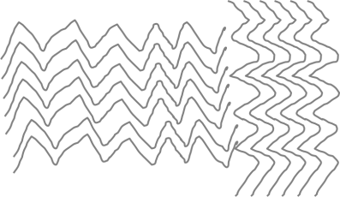
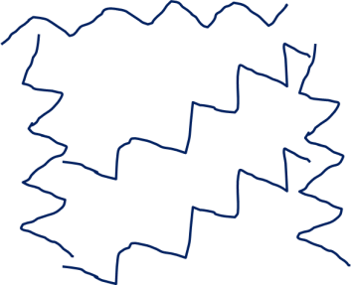
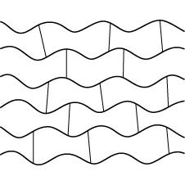
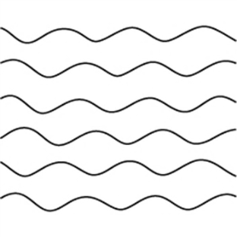
Polymers and Nanoscience
 | High density polymer – chains close together
 | Low density polymer - chains far apart
 | Some do not melt when heated, these are called thermosetting polymers. These cross-links make the material tougher and less flexible.
 | Some will soften easily, and can be moulded into shape before they are cooled down, these are called thermosoftening polymers.
The melting point of a thermosoftening polymer is determined by the strength of the INTERMOLECULAR FORCES
Nanoscience is the science of very small particles and looks at the properties of nanoparticles.
These are particles with in the range of 0·1nm to 100nm. The name 'nano' means 10⁻⁹.
A nanoparticle is about 100 atoms
Advantages | Disadvantages
Large surface area makes them effective catalysts. Nanotubes can be used in small scale circuits as nanowires. | So small they can enter the skin and therefore the bloodstream. Easily become airborne, breathing in can potentially damage the lungs.
Nanoparticles are present in sun screens
May be used to develop faster computers, lighter construction materials and new coatings

Slide 12
10 Questions
Are hydrocarbons tightly packed together in HD or LD polystyrene?
Some plastics melt when heated, what do we call them?
Some plastics do not melt when heated, what do we call them?
Why do they not melt?
What is the melting point of a thermosoftening plastic determined by?
When we grind solids up into small particles, what happens to the surface area of the solid?
What is nanoscience?
Approximately how many atoms are in a nanoparticle?
State one advantage and one disadvantage of nanoparticles?
State one use for nanoparticles.
Polymers and Nanoscience

Slide 13
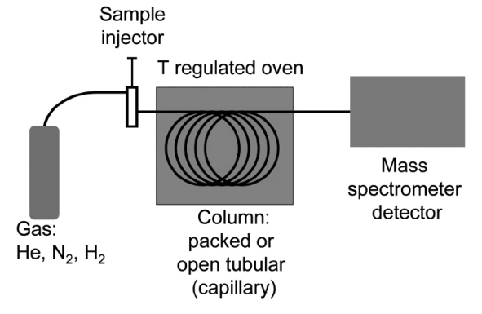
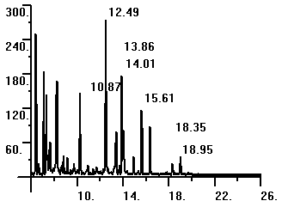
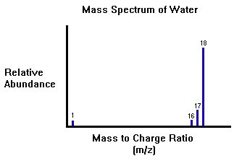
Analytical techniques
Elements and compounds can be detected and identified using instrumental methods.
GC, GC-MS
Advantages | Disadvantages
Highly accurate and sensitive. They are quicker. Enable very small samples to be analysed | Equipment is very expensive. Takes specialist training to use. results can ONLY be analysed by comparison with known data
Relative abundance
Retention time
Different substances, carried by a gas, travel through a column packed with a solid material at different speeds, so that they become separated the number of peaks on the output of a gas chromatograph shows the number of compounds present. The position of the peaks on the output indicates the retention time.
Chemical analysis can be used to identify additives in foods. Artificial colours can be detected/identified by paper chromatography
The output from the gas chromatography column can be linked to a mass spectrometer, which can be used to identify the substances leaving the end of the column by relative molecular mass
The molecular mass is given by the molecular ion peak.
A B C D
Components in a mixture can be identified by the distance they move relative to the solvent. This is the R_{f} value:
Distance moved by component
Distance moved by solvent

Slide 14
10 Questions
How can you separate…
A solid from a liquid
A liquid from a gas
A liquid from a liquid
What is an E-number?
State one advantage and one disadvantage of chromatography.
What do we call the filter paper after the chromatography experiment has ended?
What colours are present in blank inks?
What does the R_{f} value represent?
What do the initials GC-MS stand for?
Give an example of a typical carrier gas in a GC-MS.
What is the period of time a gas remains in the column of a GC-MS called?
Give a use for chromatography.
Analytical techniques

Slide 15
Calculations and moles
The relative atomic mass of an element (Ar) compares the mass of atoms of the element with the ¹²C isotope. It is an average value for the isotopes of the element
Reacting masses - What mass of calcium oxide will I get when 20 g of limestone is decomposed?
CaCO₃ ➔ CaO + CO₂
40+12+(3x16) 40+16 12+(2x16)
100g 56g 44g
As 20g is less than 100g the reaction needs to be scaled down by a factor of:
So, mass of CaO = 56x0.20 = 11.2g
The relative formula mass (Mr) of a compound
is the sum of the relative atomic masses of the
atoms in the numbers shown in the formula.
20 = 0.20 100
The relative formula mass of a substance, in
grams, is known as one mole of that substance.
Percentage of element in a compound
Empirical formula is the simplest ratio of atoms in a compound. Molecular formula is the actual ratio of atoms. e.g. What is the empirical formula of a compound containing 40.0% sulfur and 60.0% oxygen by mass?
Divide through by Ar 40 : 60 32 16 Get molar ratio 1.25 : 3.75 | Get simplest whole number ratio by dividing through by the smallest 1.25 : 3.75 1.25 1.25 = 1 : 3 SO₃
$$Percentage=\frac{total A_{r} of element}{M_{r} of compound}×100$$
Yield
The amount of a product obtained is known as the yield. When compared with the maximum theoretical amount as a percentage, it is called the percentage yield.
$$Percentage yield=\frac{Actual yield}{Theoretical yield}×100$$
SO₃

Slide 16
10 Questions
What is the definition for the relative formula mass of a compound?
What is the Ar of Cl?
What is the Mr of Na₂O?
What is the percentage of Na in Na₂O?
What is the Mr of (NH₄)₂SO₄?
What is the percentage of O in (NH₄)₂SO₄?
What is the yield of a substance?
What mass of magnesium oxide will I get when 42 g of magnesium carbonate is decomposed?
Only 18g of magnesium oxide was formed, what is the yield?
A hydrocarbon contains 75% carbon and 25% hydrogen by mass, what is the empirical formula?
Calculations and moles

Slide 17
Reaction kinetics
For a reaction to occur:
Step 1: Energy must be SUPPLIED to break bonds.
Step 2: Energy is RELEASED when new bonds are made.
A reaction is EXOTHERMIC if more energy is RELEASED then SUPPLIED (hotter). If more energy is SUPPLIED then is RELEASED then the reaction is ENDOTHERMIC (older).
In some chemical reactions, the products of the reaction can react to produce the original reactants. Such reactions are called reversible reactions and are represented:
A
+
B
C
+
D
ammonium
chloride
hydrogen
chloride
ammonia
+
NH₄Cl (s)
NH₃ (g) + HCl (g)
Even though no atoms are gained or lost in a
chemical reaction, it is not always possible to
obtain the calculated amount of a product because:
the reaction may not go to completion because it is reversible.
some of the product may be lost when it is separated from the reaction mixture
some of the reactants may react in ways different from the expected reaction.
The change from blue hydrated copper sulphate to white anhydrous copper sulphate is one of the most commonly known reversible reactions.
hydrated
copper sulphate
anhydrous copper sulphate
+
steam
CuSO₄.5H₂O (s)
CuSO₄ (s) + 5H₂O (l)
If a reversible reaction is exothermic in one direction, it is endothermic in the opposite direction. The same amount of energy is transferred in each case.
SO₃

Slide 18
10 Questions
For a reaction to occur why is energy supplied?
Why is energy released during a reaction?
If more energy is supplied than released is the reaction exothermic or endothermic?
If a reaction is endothermic will the surroundings get warmer or colder?
A reaction requires a lot of heat to take place, it is endothermic or exothermic?
Is breaking bonds an endothermic or exothermic process?
Give 2 reasons why a yield is not always 100%?
What is the symbol for a reversible reaction?
Give an example of a reversible reaction.
If a reversible reaction is exothermic in 1 direction what must it be in the other?
Reaction kinetics

Slide 19
Reaction rates
Amount of product formed
Slower rate of reaction here due to reactants being used up
Reactions occur when particles collide with sufficient energy. The minimum amount of energy required for particles to react on collision is called the activation energy.
Fast rate of reaction here
Factors affecting reaction rate
Concentration: Increasing concentration increases number of collisions and increases rate
Temperature: Particles have more energy and move faster and collide more often. More particles have energy greater than the activation energy so more successful collisions
Catalyst: Catalysts change the rate of chemical reactions but are not used up during the reaction. Different reactions need different catalysts. Catalysts are important in increasing the rates of chemical reactions used in industrial processes to reduce costs.
Pressure: Increasing pressure increases the number of collisions as the particles are closer.
Surface area: Increases the number of collisions as there is more surface exposed
Slower reaction
Time
Reaction can be followed by:
Loss in mass if gas produced.
Measuring volume of a gas produced every min.
Appearance/disappearance of colour.
Change in pH etc.
$$Rate of reaction=\frac{amount of reactant used}{time}$$
$$Rate of reaction=\frac{amount of product formed}{time}$$
SO₃

Slide 20
10 Questions
What equipment can be used to measure the mass of a product?
In terms of reactants how do we know when a reaction is completed?
State 2 ways in which a reaction can be followed.
Define activation energy.
How do catalysts effect the activation energy?
How does this change the rate of a reaction?
Describe how the following factors effect the rate of a reaction in terms of amount (frequency) of collisions and energy of collisions?
Increasing the temperature.
Decreasing the concentration.
Increasing the pressure of gaseous reactants.
Grinding up solid calcium carbonate into a powder.
Reaction rates

Slide 21
Acids and Bases
Acid | Formula | Salts
hydrochloric | HCl | chlorides
sulphuric | H₂SO₄ | sulphates
nitric | HNO₃ | nitrates
Reactions occur when particles collide with sufficient energy. The minimum amount of energy required for particles to react on collision is called the activation energy.
acid
+
metal
➔
salt
+
hydrogen
1 | 2 | 3 | 4 | 5 | 6 | 7 | 8 | 9 | 10 | 11 | 12 | 13 | 14
acid
+
base
➔
salt
+
water
Red
Green
Purple
Increasingly acidic
Increasingly basic
acid
+
carbonate
➔
salt
+
H₂O
+
CO₂
Acids give H⁺ in water
Bases accept H⁺
Alkalis are soluble bases and give OH⁻ in water
Bases include, metal oxides, metal hydroxides, metal carbonates
Neutralisation
An acid can be neutralised by a base
H⁺ (aq) + OH⁻ (aq) → H₂O (l)
Base | Acid | Salt
Calcium hydroxide | Hydrochloric acid | Calcium chloride
Magnesium oxide | Nitric acid | Magnesium nitrate
Calcium carbonate | Sulphuric acid | Calcium sulphate
Common Acids | Common Bases
hydrochloric acid - HCl | sodium hydroxide - NaOH
sulphuric acid - H₂SO₄ | potassium hydroxide - KOH
nitric acid - HNO₃ | ammonia – NH₃
SO₃

Slide 22
10 Questions
What scale is used to measure how acidic or alkaline a substance is?
What in the name and formula of the acid that can be used to make magnesium chloride from magnesium ribbon?
What is the definition of an acid?
What is the difference between an alkali and a base?
What gas is formed when an acid reacts with a metal?
How can we test for this gas?
What is the name of the salt formed when Na₂O reacts with HNO₃?
Balance and complete the following reactions:
__Mg (s) + __HCl (aq) → __MgCl₂ (aq) + __H₂ (g)
__Al₂O₃ (s) + __HCl (aq) → __AlCl₃ (aq) + __H₂O (l)
__Na₂O (s) + __H₂SO₄ (aq) →
Acids and Bases

Slide 23
Salts
Soluble salts
Metal can be reacted with an acid until the metal is used up.
Excess metal can be filtered off.
Water can be evaporated from the solution and the salt left to crystallise
Disadvantage: not all metals are suitable; some are too reactive and others are not reactive enough.
Place a known volume of alkali in a beaker
Add an indicator
Add acid dropwise until the solution is neutral. Record the amount of acid required.
Mix the same volume of alkali and acid, evaporate off some of the water and leave to crystallise
Insoluble salts
Insoluble salts can be made by mixing appropriate solutions of ions so that a precipitate is formed.
The precipitate can be separated using filter paper, washed with distilled water and left to dry.
All nitrates are soluble, all sodium salts are soluble.
acid
+
metal
➔
salt
+
hydrogen
acid
+
carbonate
➔
salt
+
H₂O
+
CO₂
acid
+
base
➔
salt
+
water
acid
+
alkali
➔
salt
+
water
Ammonia dissolves in water to produce an alkaline solution. It is used to produce ammonium salts. Ammonium salts are important as fertilisers.
Precipitation can be used to remove unwanted ions from solutions, for example in treating water for drinking or in treating effluent.

Slide 24
10 Questions
Nickel sulphate (a soluble salt) can be made by adding an excess of insoluble nickel oxide to sulphuric acid until no further reaction occurs.
Give an observation that would show you that the reaction is complete?
What equipment could be used to removed the excess nickel oxide?
What is the name of this separation method?
How you could produce crystals of nickel sulphate from nickel sulphate solution?
What other reactant could be added to H₂SO₄ to make nickel sulphate?
What is the formula of nickel (II) sulphate?
Silver chloride is an insoluble salt which is formed as a precipitate when silver nitrate and sodium chloride solutions are mixed together.
Write a word equation for this reaction.
What is the formula of silver (I) chloride?
After mixing the reactants how could the insoluble salt be separated?
Lead nitrate and sodium sulphate are reacted together in solution. Name the two salts made in this reaction?
Salts

Slide 25
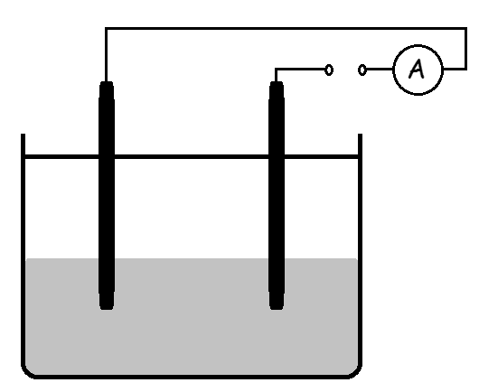
Electrolysis – Molten
When ionic compounds are melted or dissolved in water the ions can move.
This means that molten ionic compounds and solutions of ionic compounds conduct electricity.
Positive ions (CATIONS) move to the negative electrode (CATHODE).
Negative ions (ANIONS) move to the positive electrode (ANODE).
The solution or melt that is electrolysed is called the ELECTROLYTE.
+
-
Br₂
Anode
Cathode
Br⁻
Br⁻
Pb²⁺
Electrolysis of molten compounds
All ionic compounds contain positive and negative ions. We can predict the ions present from the formula and the charges on the ions using the formula and the data sheet.
During electrolysis:
The CATIONS move to the negative electrode where they GAIN electrons
The ANIONS move to the positive electrode where they LOSE electrons
e.g. lead bromide
PbBr₂ → Pb²⁺ + 2Br⁻
Pb²⁺ ions move to the cathode and gain electrons:
Pb²⁺ + 2e⁻ → Pb
Br⁻ ions move to the anode and lose electrons:
2Br⁻ → Br₂ + 2e⁻
O xidation | R eduction
I s | I s
L oss | G ain
OF ELECTRONS

Slide 26
10 Questions
Why can’t ionic solids conduct electricity?
What is the name given to the positive electrode?
What is a compound split up into using electrolysis?
What is the solution or melt that is electrolysed called?
What does the acronym O I L R I G stand for?
Br⁻ ions reach the positive electrode and loose electrons to form bromine gas, is this process oxidation or reduction?
What ions are present in calcium iodide and which electrode would each ion go to?
Balance and complete the following reactions:
__Ca²⁺ + __e⁻ → __Ca
__Cl⁻ → Cl₂ + __e⁻
__CaCl₂ → __Ca²⁺ + __Cl⁻
Electrolysis – Molten

Slide 27
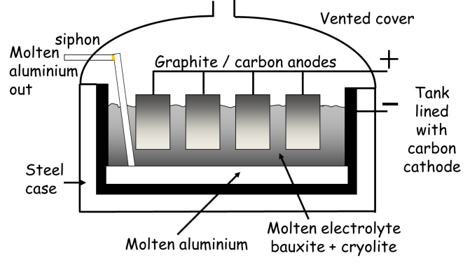
Electrolysis - Solutions
At the negative electrode, positively charged ions gain electrons (reduction) and at the positive electrode, negatively charged ions lose electrons (oxidation).
If there is a mixture of ions, the products formed depend on the reactivity of the elements involved.
Electroplating
Electrolysis is used to electroplate objects. This may be for a variety of reasons and includes copper plating and silver plating.
Passing a current through a solution containing Cu2+ ions or Ag+ ions will result in the silver or copper being deposited on the cathode.
Extraction of aluminium
Bauxite – aluminium ore containing aluminium oxide
Aluminium oxide has a very high melting point
The electrolysis takes place when the aluminium oxide is molten. It is dissolved in molten cryolite to reduce the temperature at which it melts.
This reduces energy costs
The cathode and anode are made of graphite
Brine
Compounds: sodium chloride (NaCl) and water (H₂O)
Ions: Na⁺ + Cl⁻ (Anode) --- OH⁻ + H⁺ (Cathode)
Positive electrode
2Cl⁻ → Cl₂ + 2e⁻
Negative electrode
2H⁺ + 2e⁻ → H₂
Negative electrode
3Al⁺ + 3e⁻ → Al
When the chloride ions and hydrogen ions have been discharged……NaOH is left behind
Products in the electrolysis of brine:
Chlorine (Cl₂) - used in bleach and plastics.
Hydrogen (H₂) - used in the hydrogenation of vegetable oil to make butter.
Sodium hydroxide (NaOH) - used in soap.
Positive electrode
2O²⁻ → O₂ + 4e⁻
Oxygen is released at the anode where it reacts with the graphite to form carbon dioxide. Therefore the anode needs to be replaced often

Slide 28
Electrolysis - Solutions
What is the chemical formula of salt in the sea?
What ions are present in brine?
What are the 3 products made when brine undergoes electrolysis? Give a use of each one.
What ions move towards the anode?
What ions move towards the cathode?
What gas discharged at the anode (write the ionic equation as well)?
What gas discharged at the cathode (write the ionic equation as well)?
What ions are left in solution?
What is the name of the compound left in the solution
When bauxite undergoes electrolysis what metal is formed and why does the carbon anode need to be frequently replaced?
Electrolysis – Molten

Slide 29
Mark Scheme
Atomic Structure
35
17
17 protons, 18 neutrons, 17 electrons
2,8,7
0
0
shells (or) orbitals
35.5
Isotopes - Atoms of the same element that have different numbers of neutrons
³⁵Cl – 18 neutrons
³⁷Cl – 20 neutrons
MgCl₂
= (1xMg) + (2xCl)
= (1x24) + (2x35.5)
= 24 + 71
= 95
Ionic bonding
Transfer
(a) Metals and Non-metals
-1
+3
Electrostatic
Molten (l) or in solution (aq)
8.
[2,8]⁻
CaF₂

Slide 30
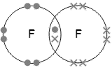
Mark Scheme
Covalent bonding - molecules
Share
(b) Non metals and Non-metals
1
5
They do not conduct electricity because the molecules do not have an overall electric charge. (or) No free electrons or ions.
Strong
8.
10. 4
Covalent bonding - Giant
4
3
In graphite, each carbon atom bonds to three others, forming layers. The layers are free to slide over each other because there are no covalent bonds between the layers and so graphite is soft and slippery.
In graphite, one electron from each carbon atom is delocalised. These delocalised electrons allow graphite to conduct heat and electricity.
No delocalised electrons.
Silicon dioxide
Macromolecules
High
Giant covalent structures are linked by strong covalent bonds and so they have very high melting points.
They are used for drug delivery into the body, lubricants and catalysts.

Slide 31
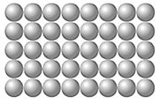
Mark Scheme
Metallic bonding
Metallic
Regular
To make them harder
Shape memory alloys
Heat them up
The outer electrons of metal atoms are delocalised and so free to move through the whole structure.
Strong electrostatic attractions.
Metals conduct heat and electricity because of the delocalised electrons.
Positive ions in a sea of delocalised electrons
Polymers and Nanoscience
High Density (HD)
Thermosoftening
Thermosetting
Cross-links in the structure
The melting point of a thermosoftening polymer is determined by the strength of the INTERMOLECULAR FORCES
Gets bigger
Nanoscience is the science of very small particles and looks at the properties of nanoparticles.
A nanoparticle is about 100 atoms
Advantages:
Large surface area makes them effective catalysts.
Nanotubes can be used in small scale circuits as nanowires.
Disadvantages:
So small they can enter the skin and therefore the bloodstream.
Easily become airborne, breathing in can potentially damage the lungs.
Sun screens (or) Bandages - others

Slide 32
Mark Scheme
Analytical techniques
(a) Filtering
(b) take the lid off
(c) chromatography
Codes for chemicals which can be used as food additives for use within the EU.
Advantages:
Highly accurate and sensitive.
They are quicker.
Enable very small samples to be analysed
Disadvantages:
Equipment is very expensive.
Takes specialist training to use.
results can ONLY be analysed by comparison with known data.
Chromatogram
All colours
Distance compound travels up chromatogram
Gas Chromatography – Mass Spectrometry
He (or) N₂ (or) H₂
Retention time
Separating a mixture of liquids (or) Money and cheques can be proven as fakes using this scientific technique - others
Calculations and moles
The relative formula mass of a substance, in grams, is known as one mole of that substance.
35.5
Na₂O
= (2xNa) + (1xO)
= (2x23) + (1x16)
= 46 + 16
= 62
% of Na = (⁴⁶/₆₂) x 100 = 74.2%
Mr of (NH₄)₂SO₄ = 132
% of O = (⁶⁴/₁₃₂) x 100 = 48.5%
The amount of a product obtained is known as the yield.
MgCO₃ → MgO + CO₂
(24+12+48) (24+16)
84g 40g
42g 20g
Yield = (¹⁸/₂₀) x 100 = 90%
C H
⁷⁵/₁₂ ²⁵/₁
6.25 25
1 4 CH₄

Slide 33
Mark Scheme
Reaction kinetics
To break bonds
Bonds are made
Endothermic
Colder
Endothermic
Endothermic
Yield is never 100% because:
The reaction may not go to completion because it is reversible.
Some of the product may be lost when it is separated from the reaction mixture
Some of the reactants may react in ways different from the expected reaction.
Endothermic
Reaction rates
Balance (or) Scales
There are no reactants remaining
Amount of product formed (and) Amount of reactant used.
Reactions occur when particles collide with sufficient energy. The minimum amount of energy required for particles to react on collision is called the activation energy.
Catalysts lower the activation energy.
Speeds it up
Rate increases as frequency and energy of collisions increases.
Rate decreases as only the frequency of collisions decreases.
Rate increases as only the frequency of collisions increases.
Rate increases as the surface area is increased, therefore increasing the frequency of collisions increases.
NH₄Cl (s)
NH₃ (g) + HCl (g)

Slide 34
Mark Scheme
Acids and Bases
pH scale
Hydrochloric acid (HCl)
Acids give H⁺ in water
Alkalis are soluble bases and give OH⁻ in water.
Hydrogen
Squeaky pop (heard when an ignition source is brought near).
Sodium nitrate
Mg (s) + 2HCl (aq) → MgCl₂ (aq) + H₂ (g)
Al₂O₃ (s) + 6HCl (aq) → 2AlCl₃ (aq) + 3H₂O (l)
Na₂O (s) + H₂SO₄ (aq) → Na₂SO₄ (aq) + H₂O (l)
Salts
Temperature would stop rising – other
Filter paper + filter funnel + conical flask
Filtering
Leave to evaporate
Nickel metal, Ni (s)
NiSO₄
AgCl
Filtering
lead sulphate (and) sodium nitrate
silver
nitrate
+
sodium chloride
➔
silver chloride
+
sodium nitrate

Slide 35
Mark Scheme
Electrolysis – Molten
Ions cannot move
Anode (Remember PANIC: Positive Anode Negative Is Cathode).
Elements
Electrolyte
OILRIG – Oxidation Is Loss, Reduction Is Gain (of electrons).
Oxidation
Ca²⁺ would go to the cathode, I⁻ would go to the anode.
Ca²⁺ + 2e⁻ → Ca
2Cl⁻ → Cl₂ + 2e⁻
CaCl₂ → Ca²⁺ + 2Cl⁻
Electrolysis - Solutions
NaCl
Na⁺, H⁺, OH⁻, Cl⁻
Hydrogen, chlorine, sodium hydroxide.
Negative ions (OH⁻, Cl⁻)
Positive Ions (H⁺, Na⁺)
Chlorine, 2Cl⁻ → Cl₂(g) + 2e⁻
Hydrogen, 2H⁺ + 2e- → H₂(g)
Na⁺ and OH⁻
Sodium hydroxide
Aluminium. Oxygen is released at the anode where it reacts with the graphite to form carbon dioxide. Therefore the anode needs to be replaced often.

